Slide 1
Lecture 6: Correlation
Jibo He, Ph.D.
Associate Professor
Wichita State University
jibo.he@Wichita.edu
Notes:
Paul Meahl

Slide 2
What is Correlation?
Correlation is a data analysis technique for describing/quantifying the degree of relationship between two variables. It addresses the question: “How are scores on one variable associated with (or related to) scores on another variable?”

Slide 3
Characteristics of Correlation
Nature/Shape of the Relation:
If a straight line describes the relation between two variables, the relation will be called a linear relation
In other cases, we can have non-linear relations (for example, described by a parabolic function or
a more complex periodic function

Slide 4
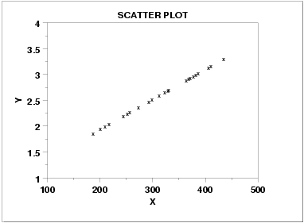
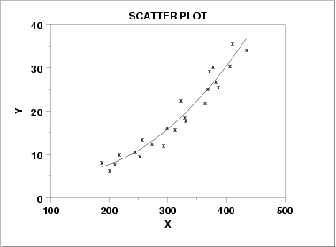
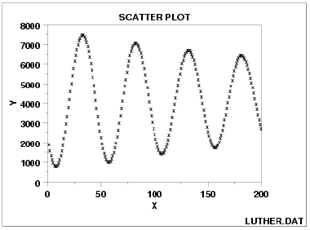
Characteristics of Correlation
Linear Relation
Parabolic function
Periodic function

Slide 5
A scatterplot
Visualize them
Scatterplot
Draw an empty graph with both an x-axis and a y-axis
Choose one variable to be on the x-axis and the other variable to be on the y-axis.
Find a particular person’s score on both variables
Mark an “x” or a “dot” at the intersection of those scores
Repeat for all of the scores in your data set.

Slide 6
Scatter Plot of Two Variables
Example 1: Here are the scores of two tests for a group of 5th graders:
Math test scores | Science test scores
18 | 15
12 | 12
5 | 9
14 | 15
20 | 19
17 | 19
18 | 15
12 | 15

Slide 7
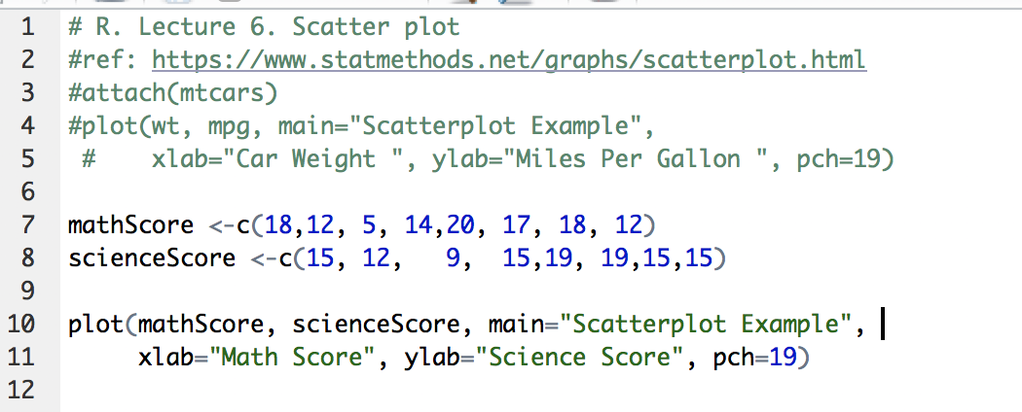
Scatter Plot of Two Variables
Example 1: Here are the scores of two tests for a group of 5th graders:
Math test scores | Science test scores
18 | 15
12 | 12
5 | 9
14 | 15
20 | 19
17 | 19
18 | 15
12 | 15

Slide 8
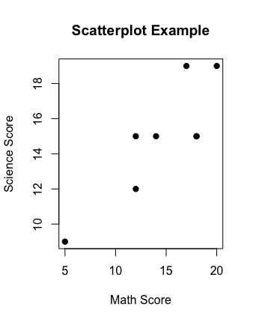
Scatter Plot of Two Variables
Example 1: Here are the scores of two tests for a group of 5th graders:
Math test scores | Science test scores
18 | 15
12 | 12
5 | 9
14 | 15
20 | 19
17 | 19
18 | 15
12 | 15

Slide 9
Characteristics of Correlation
When the relationship between variables is linear, we can use a measure of association called the correlation to describe how strongly the variables are related.
Direction of the Relation:
A POSITIVE CORRELATION exists when cases that have lower scores on X tend to have lower scores on Y and cases that have higher scores on X tend to have higher scores on Y

Slide 10
Characteristics of Correlation
A NEGATIVE CORRELATION exists when people/cases that have lower scores on X tend to have higher scores on Y and cases that have higher scores on X tend to have lower scores on Y
Depending upon the direction of relationship we can draw some conclusion: “as X scores increase, Y scores increase (or decrease).” However, we are not saying that an increase in the X scores causes the change in Y.
Notes:
Anxiety level and test performance---negative performance

Slide 11
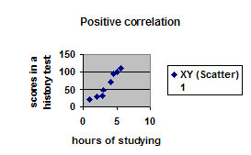
Characteristics of Correlation

Slide 12
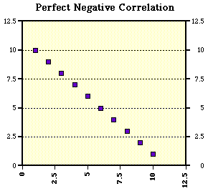
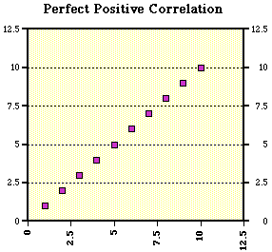
Characteristics of Correlation
Strength/Degree of the Relation:
Shows how strongly the variables are related. The strength may be assessed by noting how closely the data points lay around the straight line.

Slide 13
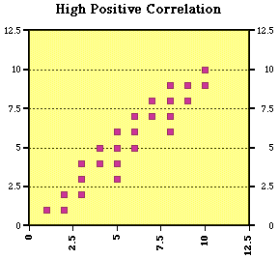
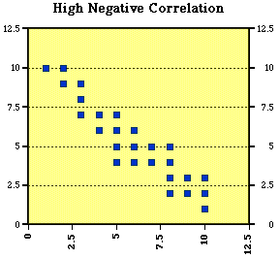
Characteristics of Correlation
Strength/Degree of the Relation:

Slide 14
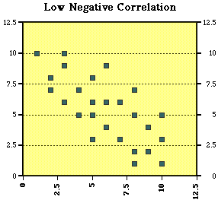
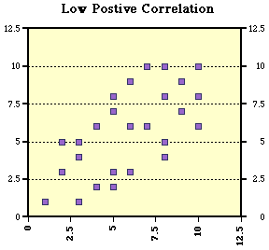
Characteristics of Correlation
Strength/Degree of the Relation:

Slide 15
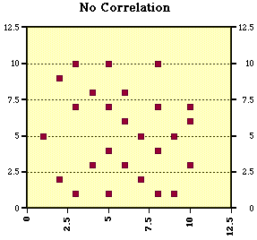
Characteristics of Correlation
Strength/Degree of the Relation:
Notes:
There is no clear clue where should the line be located, or what is the direction of the line, in this case, we say there is no correlation

Slide 16
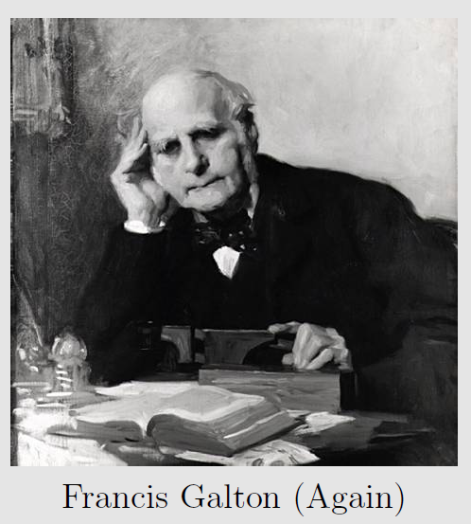
History of The Correlation
The correlation we will talk about
Was “discovered” by Galton in the 1880’s, documented in three papers

Slide 17
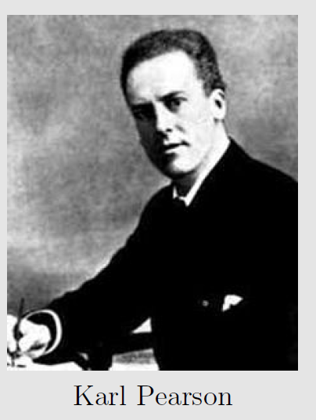
History of The Correlation
The full name is Pearson Product Moment Correlation Coefficient because
Karl Pearson worked out much of the mathematics behind it

Slide 18
Begin a little calculus, stay calm!

Slide 19
Step 1: The Covariance
The covariance: A generalization of the variance
The sample estimates of the variance and covariance
The variance is the average, squared, deviation score
The covariance is the average cross-product of deviation scores

Slide 20
Covariance
The covariance has the following properties
It measures the linear association between two variables
It can range from negative infinity to infinity
The units are frequently non-interpretable
The covariance is dependent on the measurement unit. For example, consider the covariance between height and weight if height is measured in feet and weight is measured in pounds and if height is measured in inches and weight is measured in pounds
So we have run into a problem
The interpretation of a covariance depends on the variance of the variables. If values are more spread out, they could have a larger covariance, even if the scatter plot looks the same.
How do we make our units interpretable?

Slide 21
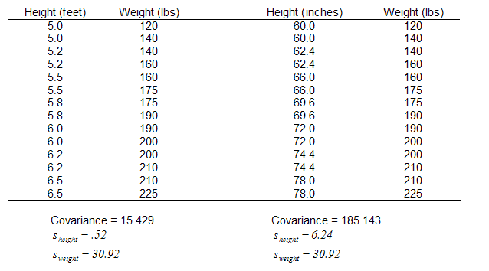
What is Covariance?

Slide 22
Step 2: From Covariance to Correlation
If we divide the covariance by the standard deviations of each variable, the problem goes away, and we are left with a unit-less (unit-free) measure of association, called the Pearson correlation coefficient. The Pearson correlation coefficient is symbolized by r_{xy} or r
Notes:
Show a calculation example

Slide 23
How to calculate the Pearson correlation coefficient when you have the raw scores?
Step 1: List the pairs of scores in two columns
Step 2: Find the mean for X and the mean for Y
Step 3: Find the deviation score (that is, the signed difference from the mean) for each raw score

Slide 24
How to calculate the Pearson correlation coefficient when you have the raw scores?
Step 4: To calculate the numerator of the above formula, multiply the deviation scores for each person. Sum the cross-products .
Step 5: To obtain the denominator, calculate the sum of squares (SS) for X and Y. Then multiply the results.
Step 6: Divide the result of step 4 by the result of step 5

Slide 25
Example
Are study hours and final exam scores correlated and how?
Study Hours (X) | Regents Score (Y)
3 | 12
5 | 15
2 | 12
8 | 17
7 | 19

Slide 26
Example
First, draw a scatter plot and try to predict the correlation coefficient from the shape of the plot.

Slide 27
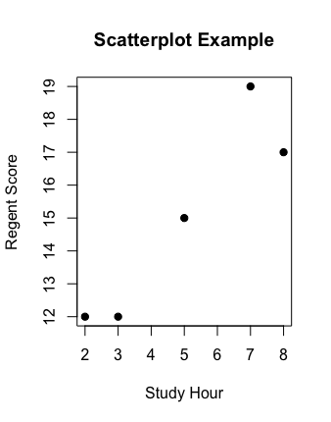
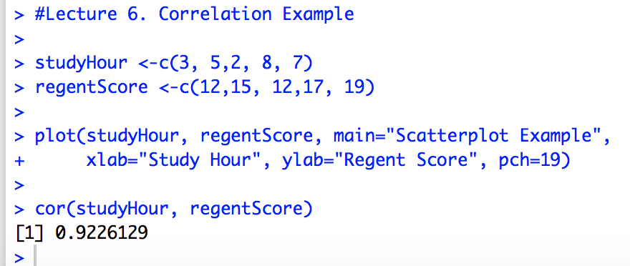
Example
First, draw a scatter plot and try to predict the correlation coefficient from the shape of the plot.

Slide 28
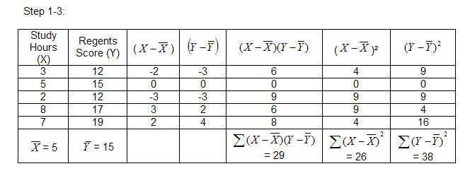
Example
Then, calculate the correlation coefficient using the formula and the steps given in previous slides.

Slide 29
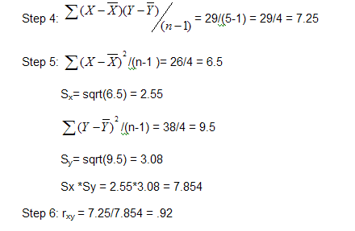
Example

Slide 30
Properties of the correlation coefficient
It indicates the strength of a linear relation (its absolute value) and the direction of the relation (its sign).
It takes values from –1 to +1 (-1 indicates perfect negative linear correlation, 0 indicates no linear correlation and +1 indicates perfect positive linear correlation).
The further the correlation is from 0, the stronger the linear relationship between the variables.

Slide 31
A few notes about the correlation coefficient
1)Variables of interest, X & Y, are both quantitative continuous measures (interval or ratio scale)
2)The correlation is only appropriate for situations in which X & Y are linearly related, or theorized to be linearly related. Therefore, you must always confirm a linear relationship between X & Y using a scatterplot before computing r_{xy}.
3) When the relationship between X & Y is nonlinear, r_{xy} will underestimate the degree of association between X & Y

Slide 32
A few notes about the correlation coefficient
Correlation simply describes a relationship between two variables. It should not and cannot be interpreted as proof of a cause-and-effect relationship between the two variables.
Correlation does not establish causation
We can say that people who score higher on the income variable also score higher on the achievement variable.
It does NOT mean that: raising family income for Mary Smith will automatically raise her academic achievement→ we are not speaking about cause and effect.

Slide 33
Correlation Recommendations
Jacob Cohen (1988) set guidelines for small, medium, and large correlations in the social sciences:
Small: .10— .30
Median: .30— .50
Large: .50—1.0
The above are recommendations based on the magnitude of the correlation, which is another way of saying their “absolute value.”
Notes:
Stronger correlation

Slide 34
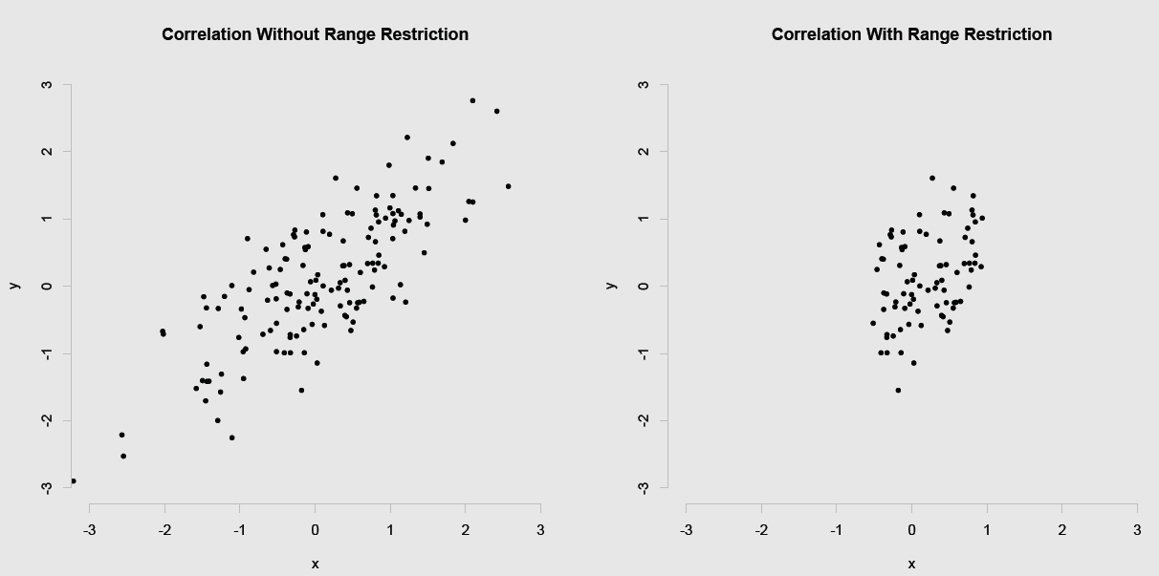
Factors that might affect correlation: Range Restriction

Slide 35
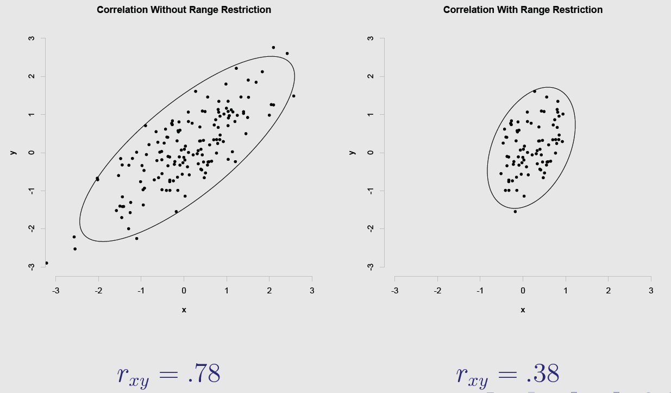
Factors that might affect correlation: Range Restriction
Notes:
What are examples of range restriction?—ceiling and floor effects; self-selection into the sample of data; experimenter selection into the sample of data

Slide 36
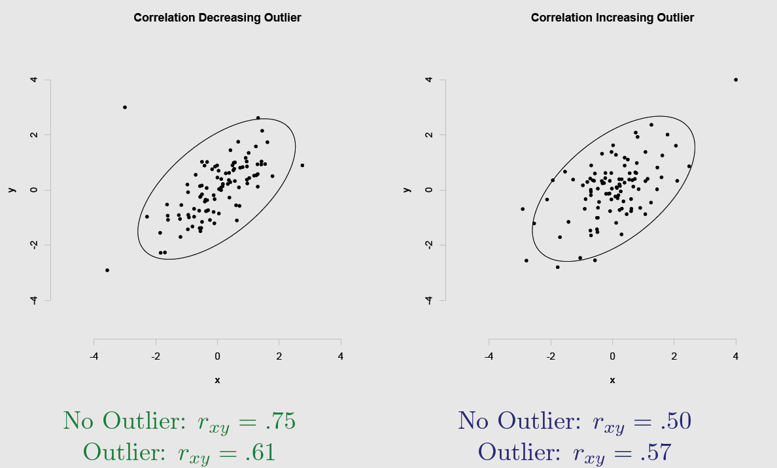
Outliers

Slide 37
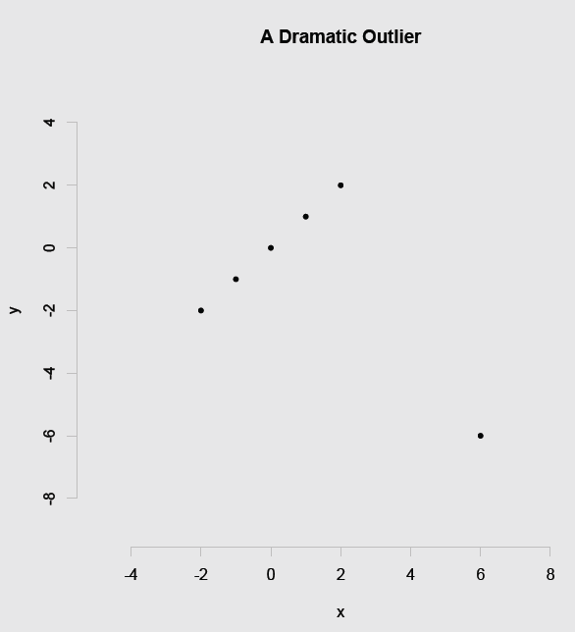
A Dramatic Outlier
An outlier can have devastating effects
The correlation without the outlier?
The correlation with the outlier: -.5
Correlation can change directions!

